Slide 1
Hands on Generative AI
Text Classification

Slide 2
Text Classification
Feed forward Networks

Slide 3
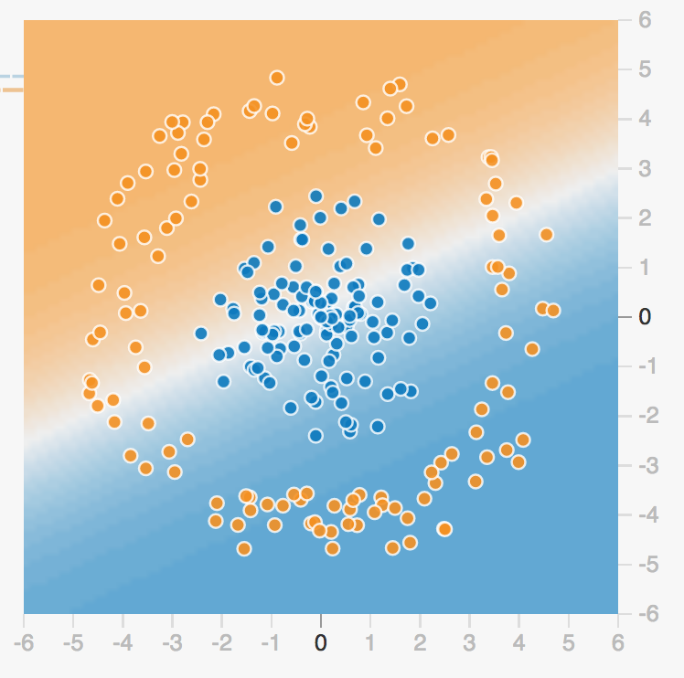
Separability
Text Classification
Can we separate this points to
Classify correctly the class
(seniment, category, etc… ?)
Playground

Slide 4
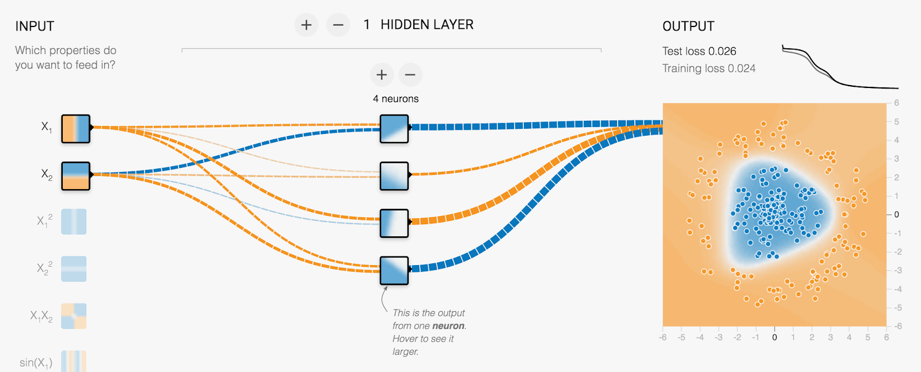
More neurons == nonlinearities
Text Classification
Playground

Slide 5
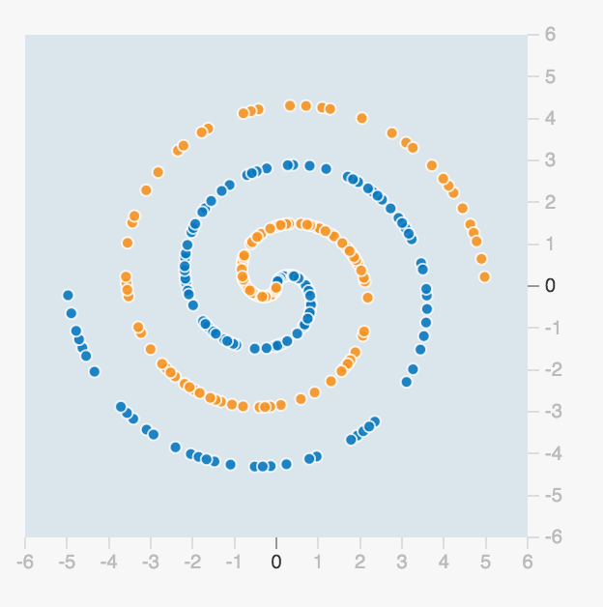
How can we do to split these?
Text Classification

Slide 6
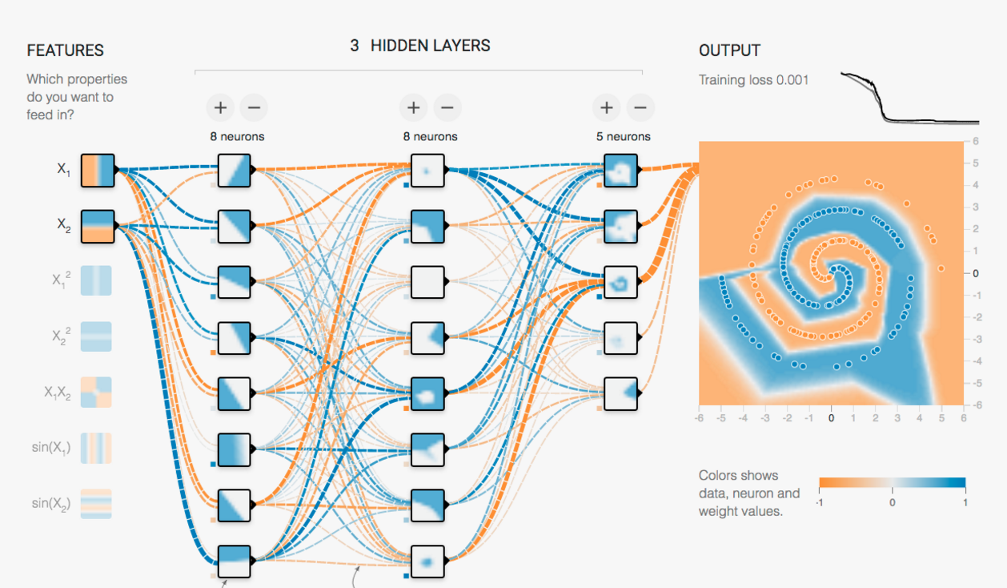
Again, mini-lines help!
Text Classification
Playground

Slide 7
In code
Text Classification
model = Sequential()
model.add(Embedding(input_dim=256,
output_dim=100,
input_length=188,
embeddings_initializer=Constant(weights),
trainable=True)
)
model.add(Dense(25, activation=leaky_relu))
model.add(Lambda(lambda x: K.mean(x, axis=1), output_shape=(None, embedding_dim)))
model.add(Dense(10, activation=leaky_relu))
model.add(Dense(1, activation='softmax'))
Define a
Sequential
model

Slide 8
In code
Text Classification
model = Sequential()
model.add(Embedding(input_dim=256,
output_dim=100,
input_length=188,
embeddings_initializer=Constant(weights),
trainable=True)
)
model.add(Dense(25, activation=leaky_relu))
model.add(Lambda(lambda x: K.mean(x, axis=1), output_shape=(None, embedding_dim)))
model.add(Dense(10, activation=leaky_relu))
model.add(Dense(1, activation='softmax'))
Add an embedding layer to the model

Slide 9
In code
Text Classification
model = Sequential()
model.add(Embedding(input_dim=256,
output_dim=100,
input_length=188,
embeddings_initializer=Constant(weights),
trainable=True)
)
model.add(Dense(25, activation=leaky_relu))
model.add(Lambda(lambda x: K.mean(x, axis=1), output_shape=(None, embedding_dim)))
model.add(Dense(10, activation=leaky_relu))
model.add(Dense(1, activation='softmax'))
Size of the vocabulary

Slide 10
In code
Text Classification
model = Sequential()
model.add(Embedding(input_dim=256,
output_dim=100,
input_length=188,
embeddings_initializer=Constant(weights),
trainable=True)
)
model.add(Dense(25, activation=leaky_relu))
model.add(Lambda(lambda x: K.mean(x, axis=1), output_shape=(None, embedding_dim)))
model.add(Dense(10, activation=leaky_relu))
model.add(Dense(1, activation='softmax'))
Size of the embedding space

Slide 11
In code
Text Classification
model = Sequential()
model.add(Embedding(input_dim=256,
output_dim=100,
input_length=188,
embeddings_initializer=Constant(weights),
trainable=True)
)
model.add(Dense(25, activation=leaky_relu))
model.add(Lambda(lambda x: K.mean(x, axis=1), output_shape=(None, embedding_dim)))
model.add(Dense(10, activation=leaky_relu))
model.add(Dense(1, activation='softmax'))
Maximum length of input sequences

Slide 12
In code
Text Classification
model = Sequential()
model.add(Embedding(input_dim=256,
output_dim=100,
input_length=188,
embeddings_initializer=Constant(weights),
trainable=True)
)
model.add(Dense(25, activation=leaky_relu))
model.add(Lambda(lambda x: K.mean(x, axis=1), output_shape=(None, embedding_dim)))
model.add(Dense(10, activation=leaky_relu))
model.add(Dense(1, activation='softmax'))
Initializer for the embedding weights

Slide 13
In code
Text Classification
model = Sequential()
model.add(Embedding(input_dim=256,
output_dim=100,
input_length=188,
embeddings_initializer=Constant(weights),
trainable=True)
)
model.add(Dense(25, activation=leaky_relu))
model.add(Lambda(lambda x: K.mean(x, axis=1), output_shape=(None, embedding_dim)))
model.add(Dense(10, activation=leaky_relu))
model.add(Dense(1, activation='softmax'))
The embedding weights should be updated during training

Slide 14
In code
Text Classification
model = Sequential()
model.add(Embedding(input_dim=256,
output_dim=100,
input_length=188,
embeddings_initializer=Constant(weights),
trainable=True)
)
model.add(Dense(25, activation=leaky_relu))
model.add(Lambda(lambda x: K.mean(x, axis=1), output_shape=(None, embedding_dim)))
model.add(Dense(10, activation=leaky_relu))
model.add(Dense(1, activation='softmax'))
Add a fully connected layer of 25 hidden units

Slide 15
In code
Text Classification
model = Sequential()
model.add(Embedding(input_dim=256,
output_dim=100,
input_length=188,
embeddings_initializer=Constant(weights),
trainable=True)
)
model.add(Dense(25, activation=leaky_relu))
model.add(Lambda(lambda x: K.mean(x, axis=1), output_shape=(None, embedding_dim)))
model.add(Dense(10, activation=leaky_relu))
model.add(Dense(1, activation='softmax'))
Calculate the mean of values

Slide 16
In code
Text Classification
model = Sequential()
model.add(Embedding(input_dim=256,
output_dim=100,
input_length=188,
embeddings_initializer=Constant(weights),
trainable=True)
)
model.add(Dense(25, activation=leaky_relu))
model.add(Lambda(lambda x: K.mean(x, axis=1), output_shape=(None, embedding_dim)))
model.add(Dense(10, activation=leaky_relu))
model.add(Dense(1, activation='softmax'))
Add a fully connected layer of 10 hidden units

Slide 17
In code
Text Classification
model = Sequential()
model.add(Embedding(input_dim=256,
output_dim=100,
input_length=188,
embeddings_initializer=Constant(weights),
trainable=True)
)
model.add(Dense(25, activation=leaky_relu))
model.add(Lambda(lambda x: K.mean(x, axis=1), output_shape=(None, embedding_dim)))
model.add(Dense(10, activation=leaky_relu))
model.add(Dense(4, activation='softmax'))
Softmax returns probabilities

Slide 18
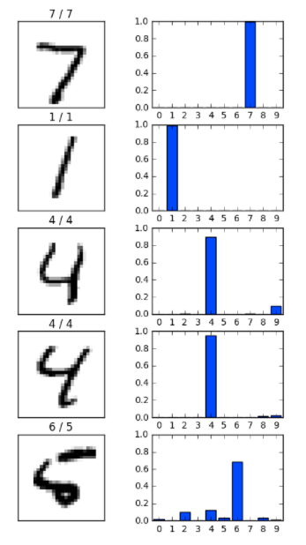
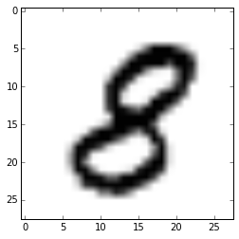
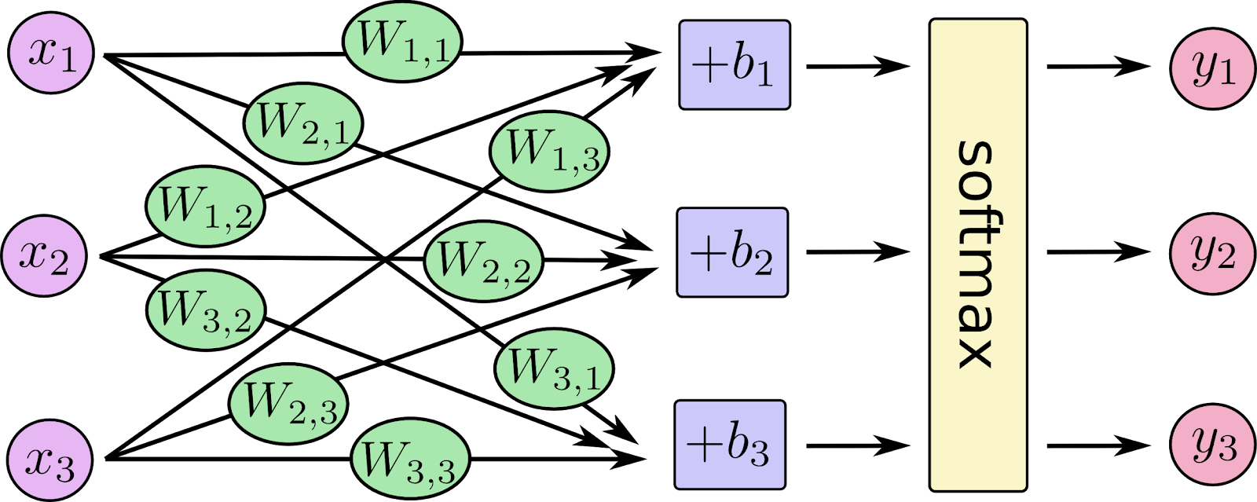
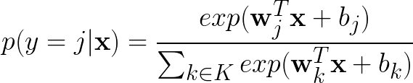
Softmax
Text Classification
Input vector
(pixel data)

Slide 19
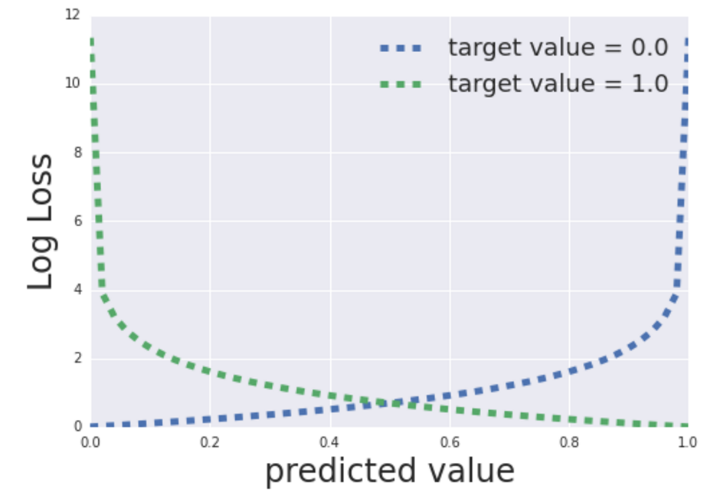
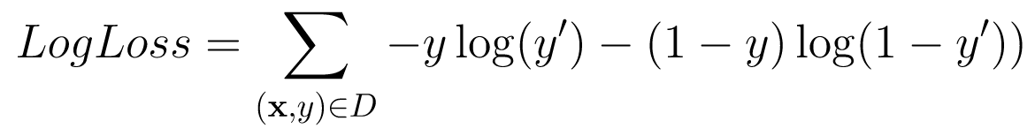
BinaryCrossEntropy (from logits if no sigmoid)
Text Classification
If doing multi class, use CategoricalCrossEntropy

Slide 20

LAB
Text Classification
News Classifier with NLP
Use a feed forward neura network to classify news headlines!

Slide 21

Summary
Text Classification
Adding more layers to neural networks results in a nonlinear decision boundary.
This way we can make classification on text.
FFN have ton of parameters, so they tend to not scale when the vocal is big, or the training set is complex.
One thing you can do as homework is add fine-tuning of a pertained embedding layer to imporve results!

